Slide 1

SYSTEM IDENTIFICATION FOR RATE PREDICITON in OIL WELLS
Felipe da Costa Pereira
Pedro Henrique Cardoso Paulo

Slide 2
agenda
- Problem description
- Literature review
- Dataset
- Methods
- Results
- Concluding Remarks
- Future work

Slide 3
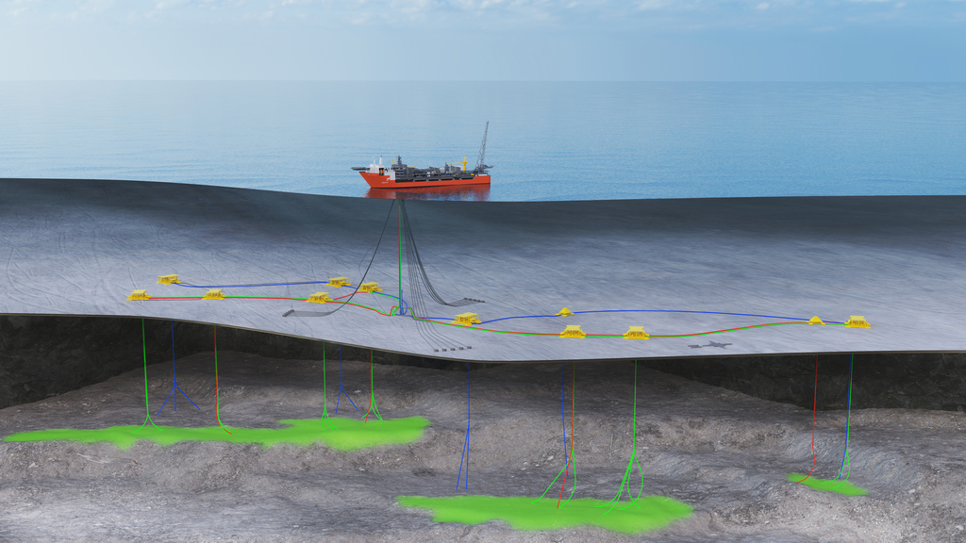
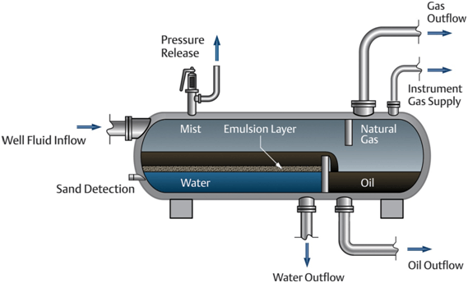
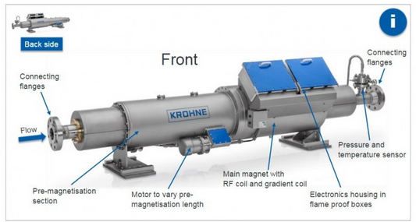
Problem description
[Tracerco.com - Johan Castberg Field, offshore Norway]
Flow rates estimation: Characteristics and Limitations
On a oil and gas production system, the production from each well is uncertain
Well rate is an apportionment of the total production
Measures need to be made after phase separation, one well at a time: test separator
Alternative: multiphase flowmeters
Associated error, calibration is a challenge;
Pressure drop, production loss;
Not accepted by ANP;
One per well, expensive
Impacts
Unreliable production history (3-D simulator input)
Poor capacity to take reservoir management decisions
Offshore Production system
[arab-oil-naturalgas.com]
Multiphase Flowmeter [krohne.com]
3-Phase separator vessel (oil/water/gas)

Slide 4
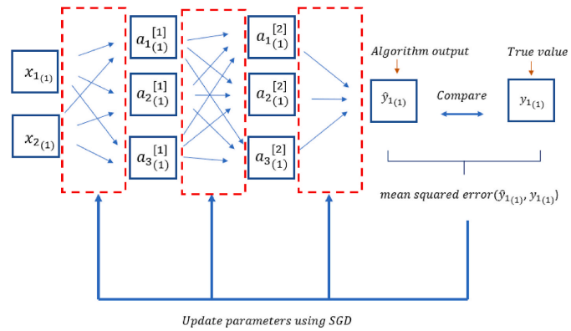
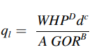
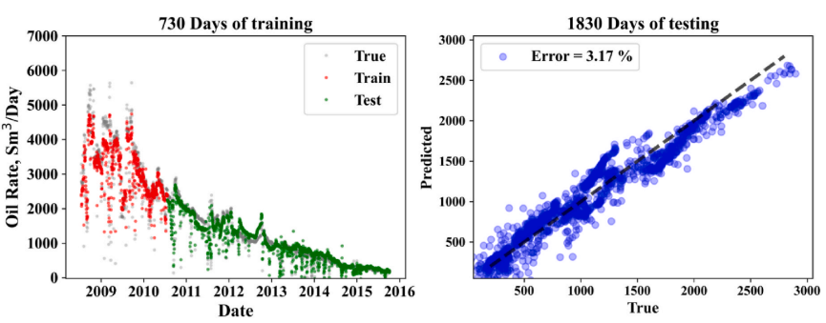
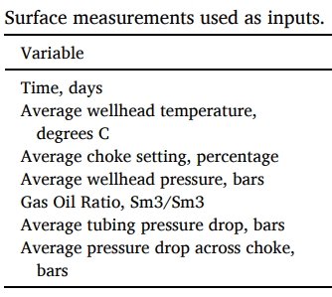
Literature review Article 01
[Alakeely, A. A., & Horne, R. N., 2021,
Journal of Petroleum Science and Engineering]
Gilbert correlation (widely used) and Deep Learning (DL) algorithms to the problem of liquid flow prediction
Wellhead surface measurements used in modeling their relationship to well production rate
Feature extraction with autoencoders (trained separately)
Real field data: Volve field well 15/9-F-14
Stochastic gradient descent (SGD) to optimize the DL algorithms
Eq: Gilbert (1954)
Figure: Optimization process, optimization using SGD
Figure: Oil prediction and error

Slide 5
Literature review Other related works
Paper | Input | Output | Method | Simulation | Data
Alakeely, Horne [2021] | Surface measures Choke, GOR, WHP | Liquid/Oil rate Water cut | Neural Network, Autoencoders | Free response | Well 15/9-F-14 (Volve)
Jouradanou et al. [2019] | Valves position | Pressures (riser inlet and bottom-hole) | Echo State Network | Free response | OLGA(*)
Aguirre et al. [2017] | Various Process variables | BHP | MLP, NARMAX, NFIR, Kalman filters | Free response | Real wells (Petrobras)
Freitas et al. [2021] | Gas lift Flow Rate | BHP | MLP Steady State response | Free response | 2 simulated systems, 1 Deep water oil well
Apio et al. [2019] | Tubing Pressure Riser Pressure | BHP | Kalman Filters | Free response | 2 OLGA(*) cases 1 real well (Petrobras)
Liu et al. [2022] | No input (auto-regressive) | Oil Rate | ESN + GA | Short term forecast (15%) | 2 China + 1 US oil Fields
(*) OiL and GAs dynamic multiphase flow simulator

Slide 6
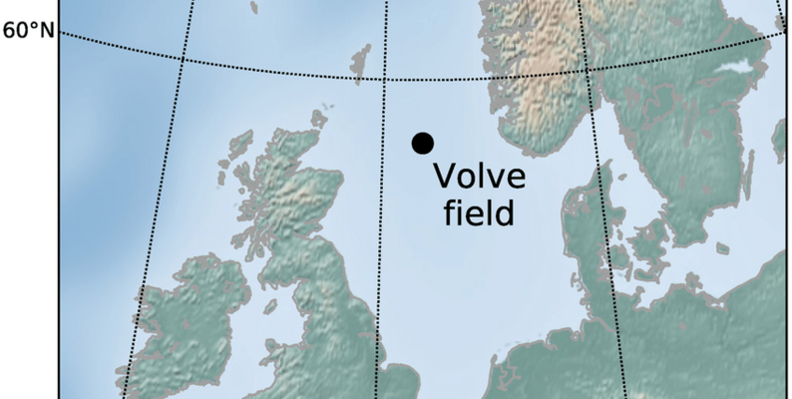
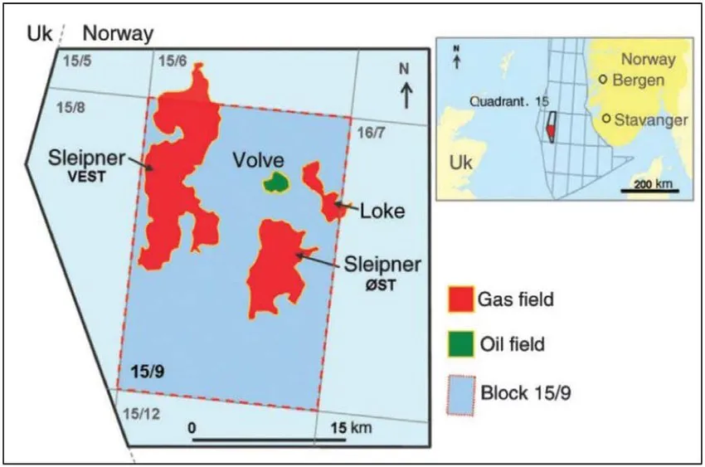
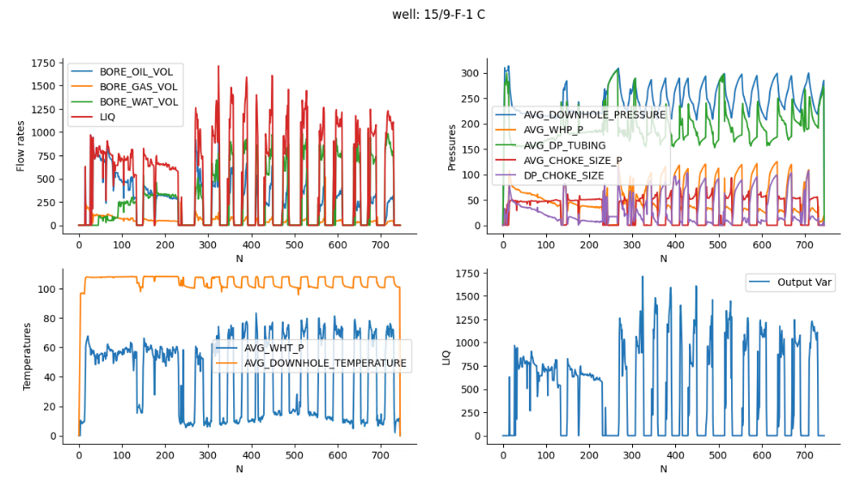
dataset
Dataset Volve Field Data
Volve Field Dataset
Production history, geological data and reservoir model provided by Equinor
Disclosed in 2018 by Equinor
6 production wells + 1 water injector well
Available well data:
Temperature and Pressures
Well head, X-mas Tree and bottomhole
Choke openings and pressure drop
Oil, water and gas rates
www.equinor.com

Slide 7







Methods: NUMERICAL EXPERIMENT PIPELINE
Estimators:
sysidentpy estimators,
SYSIDRegressor + RandomizedSearchCV (sklearn)
Train +
validation
70% first
Data importation: Volve dataset from Equinor
Best order search (from lag=2 to lag=20)
Input set selection (SISO or MISO)
Best model for each classifier (R2 criteria for train set)
Test
30% last
Evaluation

Slide 8
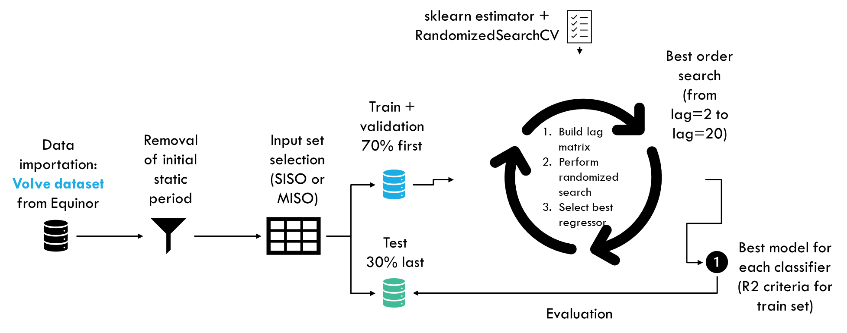

sklearn estimator + RandomizedSearchCV
Best order search (from lag=2 to lag=20)
Train +
validation
70% first
Removal of initial static period
Input set selection (SISO or MISO)
Build lag matrix
Perform randomized search
Select best regressor
Data importation: Volve dataset from Equinor
Test
30% last
Best model for each classifier (R2 criteria for train set)
Evaluation

Slide 9
Methods: SYSIDRegressor
Apply pre-processor
Ex.: Normalizer from sklearn
Create lag matrix
Support for multiple inputs
Feature expansion
Ex.: PolynomialFeatures
Support for multiple outputs
Regression
Sklearn-compatible regressors
RandomizedSearchCV
Prediction
Validation
OSA
FS
nSA
Correlation Tests
SYSIDRegressor Pipeline
Class created in order to allow system identification with any sklearn-compatible regressor
Does not allow the application of information criteria
Does not allow moving average terms
Able to simulate simplified versions of ARX and NARX architectures

Slide 10
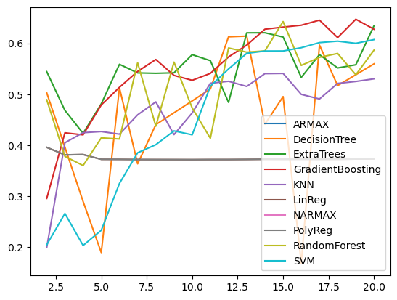
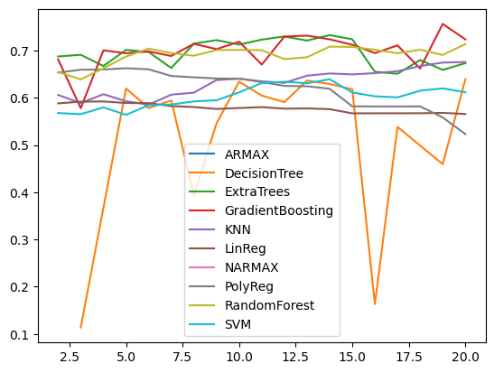
Results EVALUATED MODELS
Package | Classifier | Parameters [value or range]
sysidentpy | Armax | Polynomial(degree=1)
 | Narmax | Polynomial(degree=2)
SYSIDRegressor + sklearn | LinearRegressor | 'positive': [True, False]
 | PolynomialFeatures + LinearRegressor | 'positive': [True, False], ‘degree’: [2]
 | SVM | 'C' : stats.loguniform(1e-3, 1e3), 'kernel’ : ['poly', 'rbf', 'sigmoid','linear’], 'degree' : stats.randint(2,6), 'gamma’ : stats.loguniform(1e-4, 1e0),
 | KNN | 'n_neighbors' : stats.randint(1,100), 'weights' : ['uniform', 'distance'],
 | DecisionTree | 'splitter' : ['best', 'random’], 'max_depth' : stats.randint(5,20), 'min_samples_split’ : stats.randint(2,20), 'min_samples_leaf' : stats.randint(1,20), 'max_features' : stats.uniform(0,1), 'max_leaf_nodes' : stats.randint(10,150)
 | RandomForest | 'n_estimators' : stats.randint(5,100), 'max_depth' : stats.randint(1,20), 'min_samples_split' : stats.randint(2,20), 'min_samples_leaf' : stats.randint(1,20), 'max_features' : stats.uniform(0,1), 'max_leaf_nodes' : stats.randint(10,150)
 | GradientBoosting | 'n_estimators' : stats.randint(5,100), 'loss' : ['squared_error', 'absolute_error', 'huber', 'quantile’], 'learning_rate' : stats.loguniform(1e-5, 1e1), 'criterion' : ['friedman_mse', 'squared_error'], 'subsample' : stats.uniform(), 'max_depth' : stats.randint(1,20), 'min_samples_split' : stats.randint(2,20), 'min_samples_leaf' : stats.randint(1,20), 'max_features' : stats.uniform(0,1), 'max_leaf_nodes' : stats.randint(10,150)
 | ExtraTrees | 'n_estimators' : stats.randint(5,100), 'criterion' : ['squared_error', 'absolute_error’], 'max_depth' : stats.randint(1,20), 'min_samples_split' : stats.randint(2,20), 'min_samples_leaf' : stats.randint(1,20), 'max_features' : stats.uniform(0,1), 'max_leaf_nodes' : stats.randint(10,150)
Default information criteria from sysidentpy enabled
RandomizedSearchCV applied for sklearn estimators
SISO estimation using only choke size as input
Reference well: 15/9-F-1-C
SISO
MISO

Slide 11
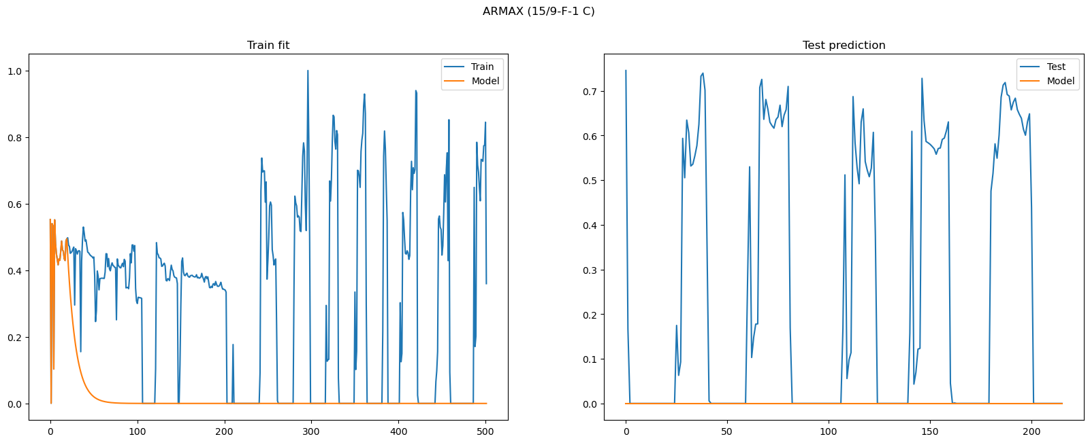
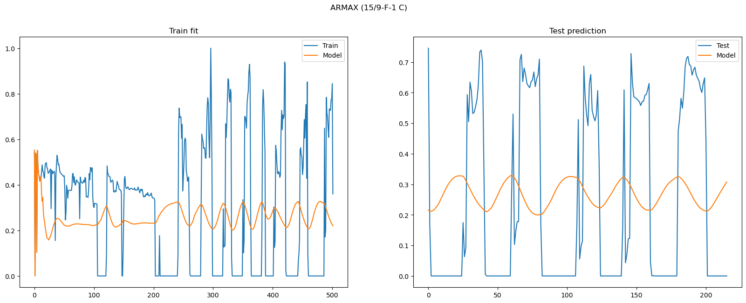
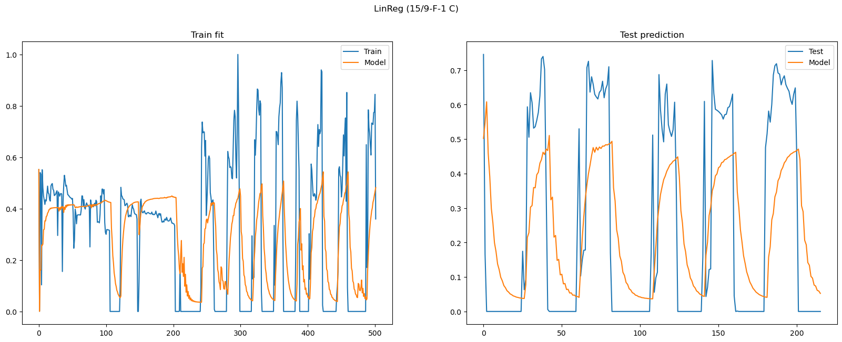
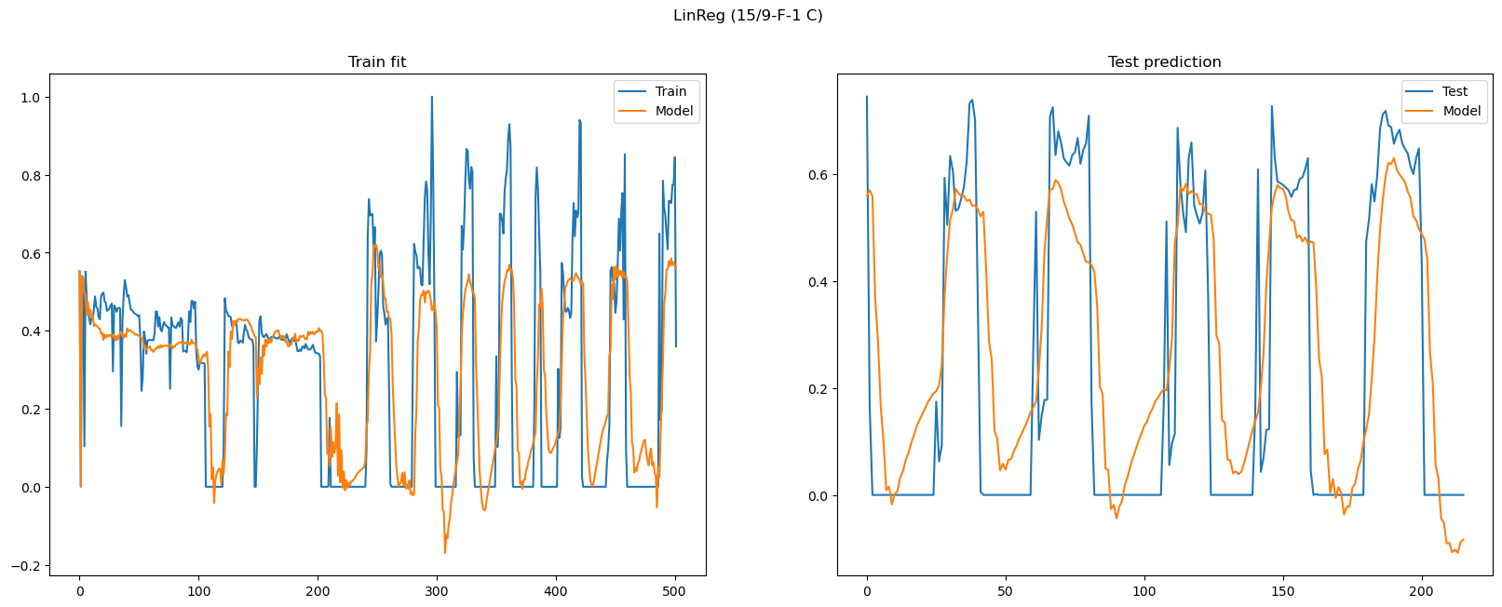
Results LINEAR MODELS
SISO
MISO

Slide 12

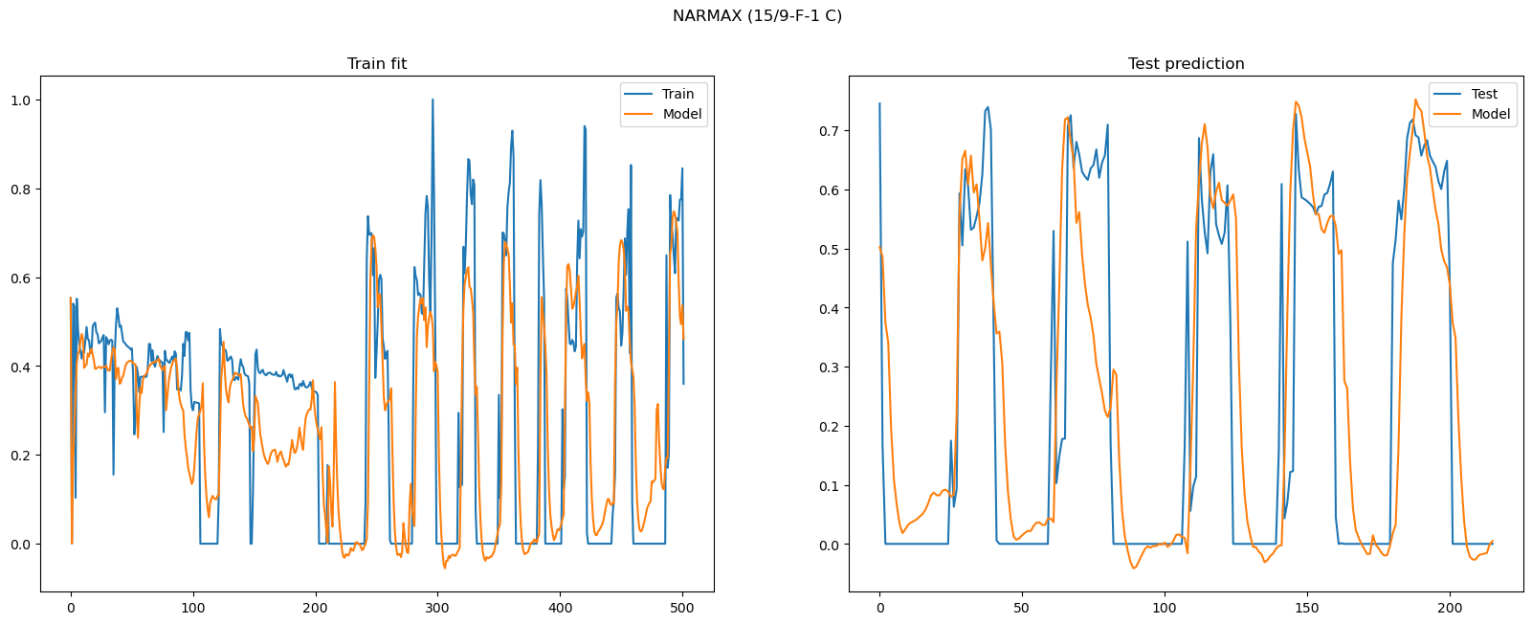
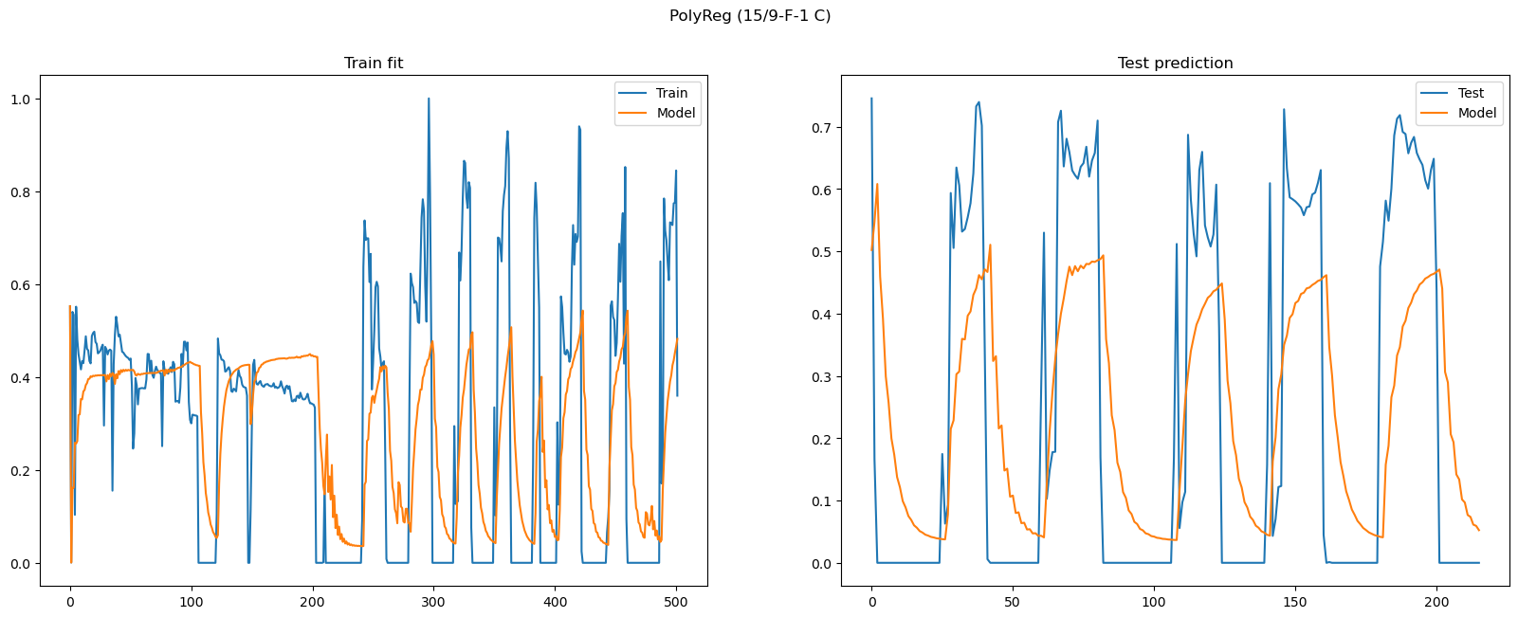
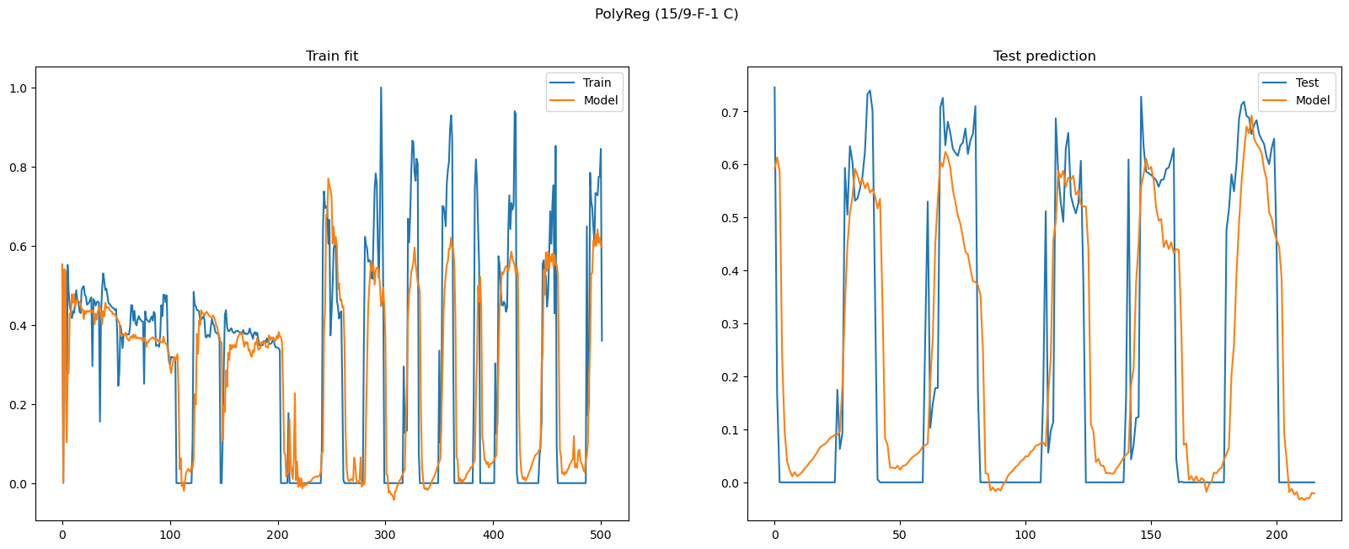
Results polynomial MODELS
SISO
MISO

Slide 13
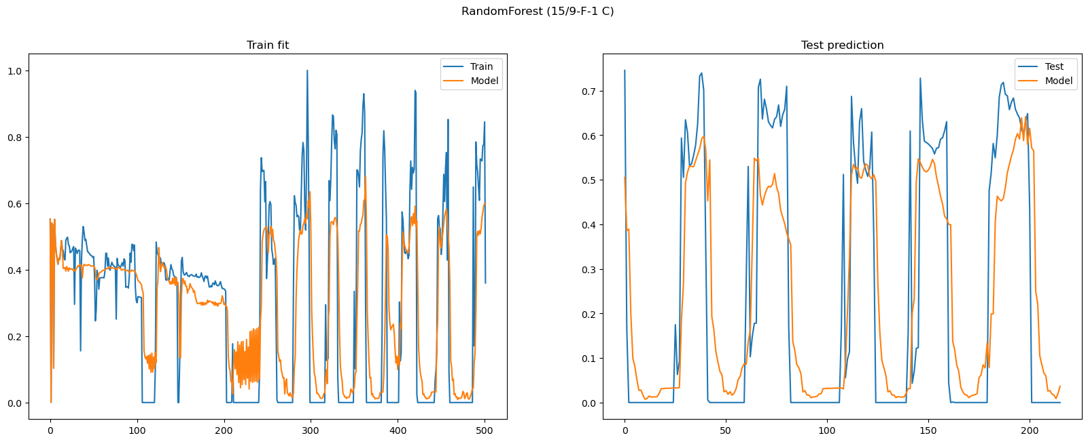
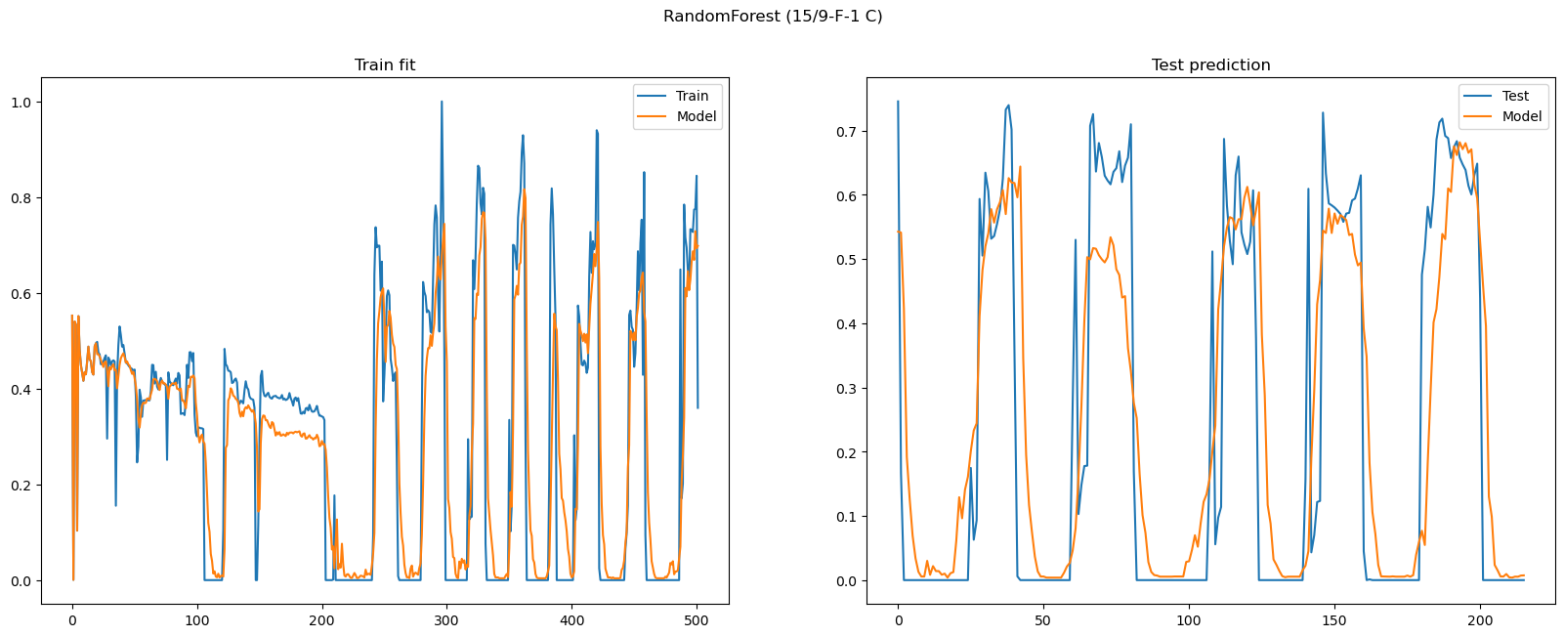
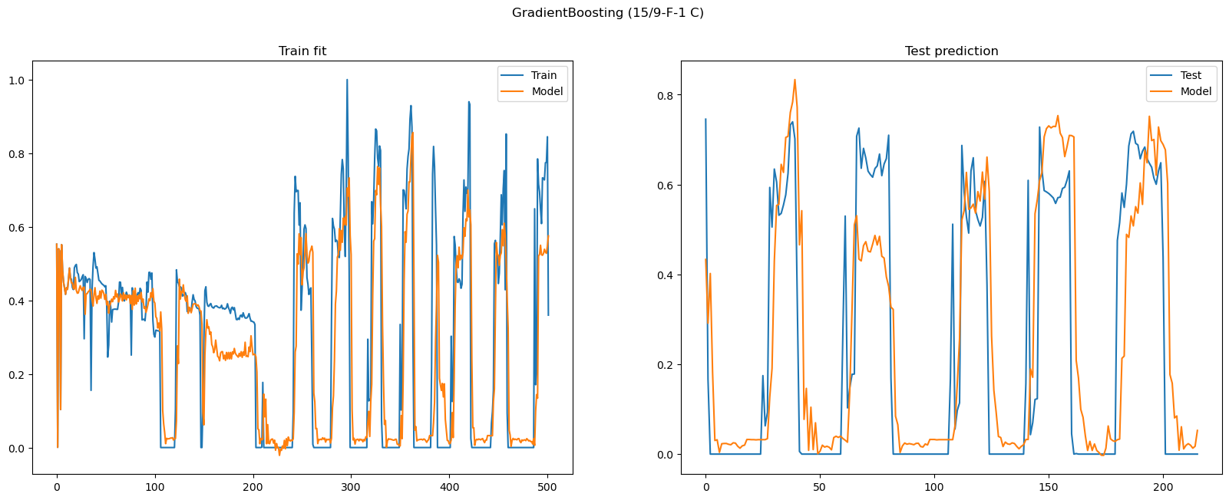
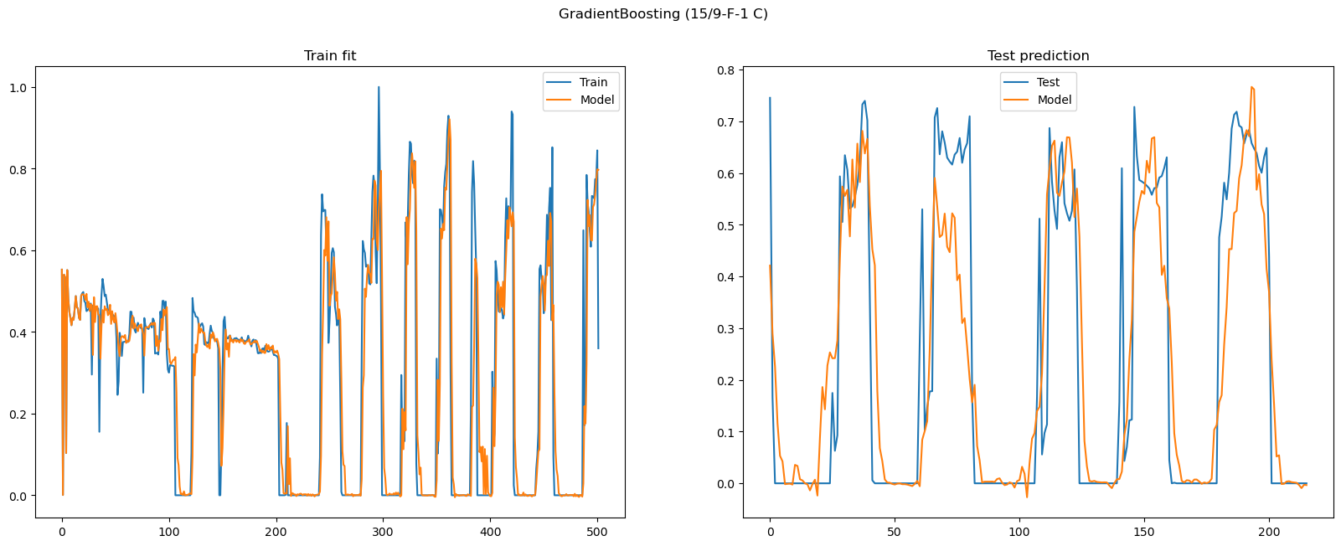
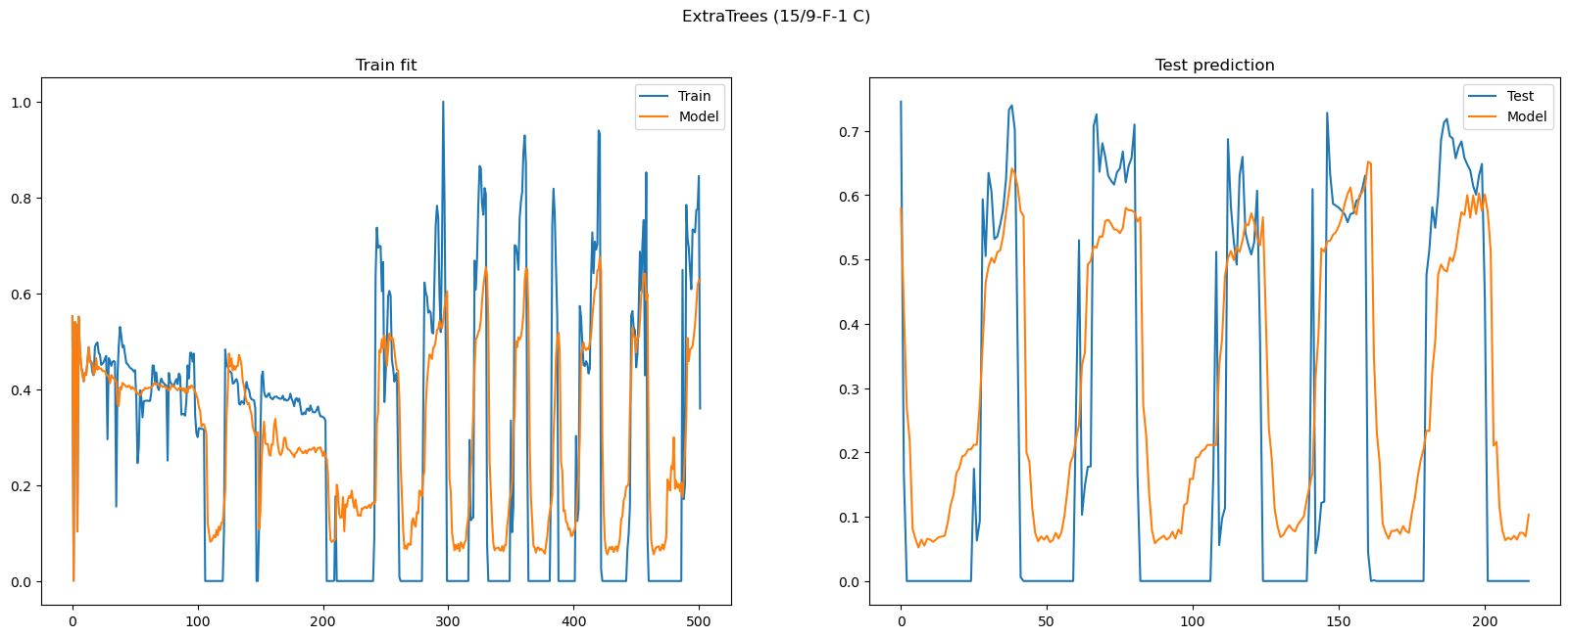
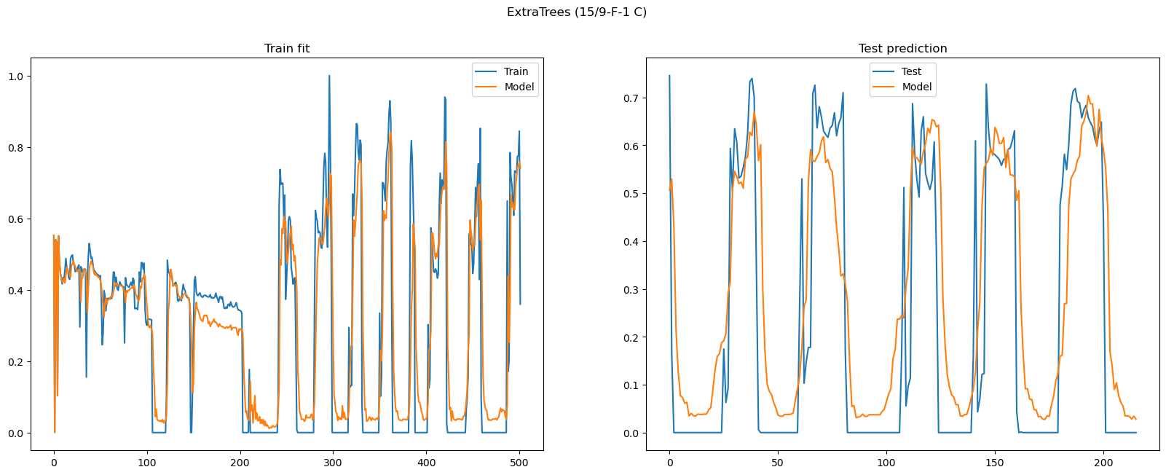
Results Forest MODELS
SISO
MISO

Slide 14
Results Forest MODELS
SISO
MISO

Slide 15
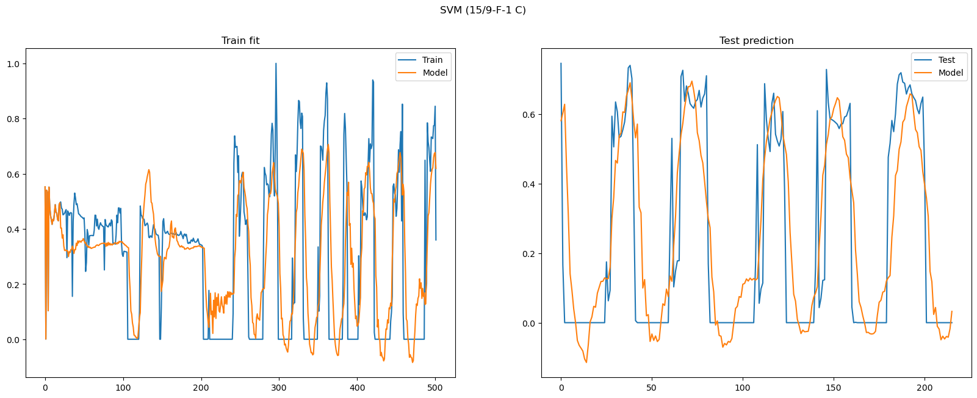
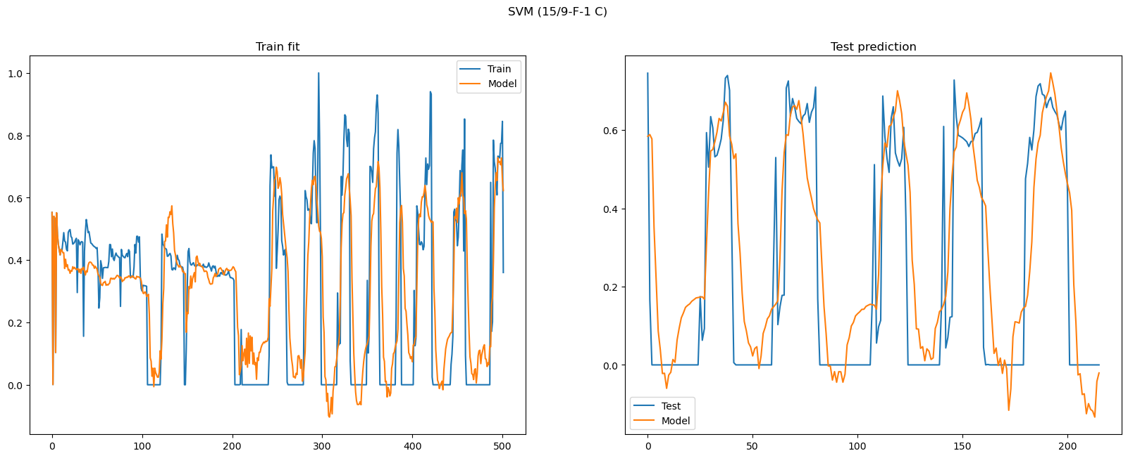
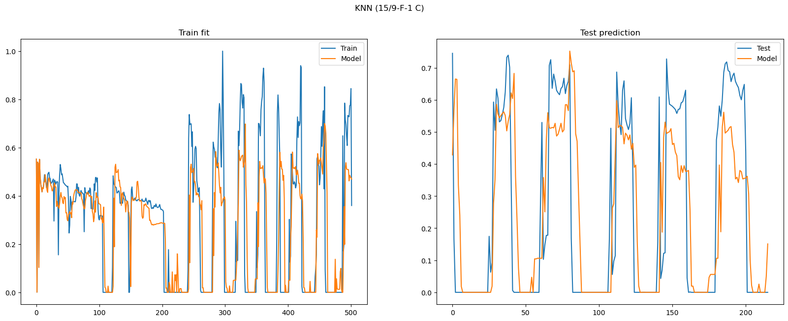
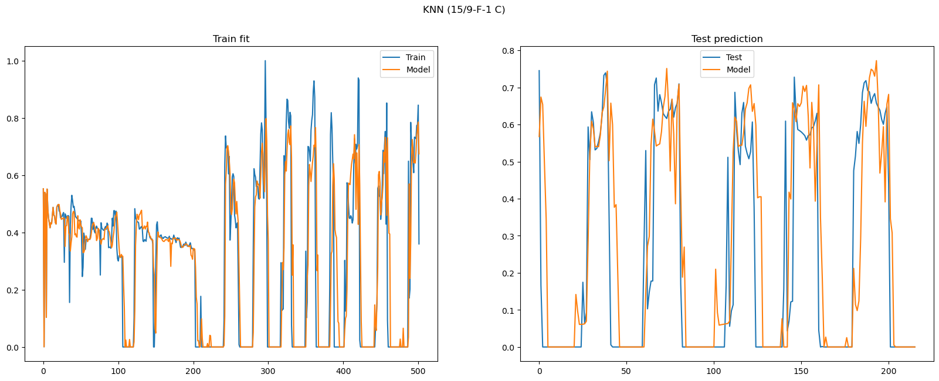
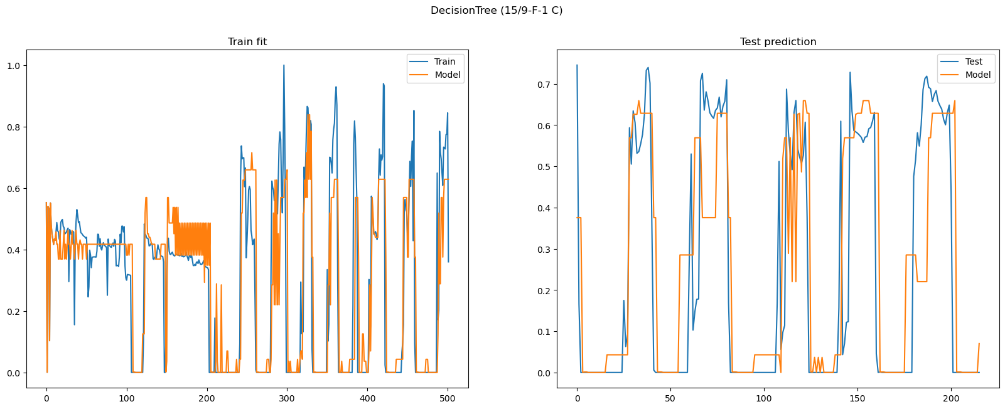
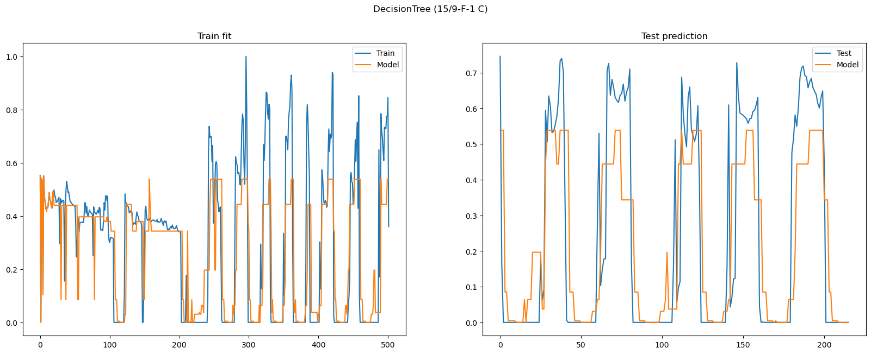
Results other MODELS
SISO
MISO

Slide 16
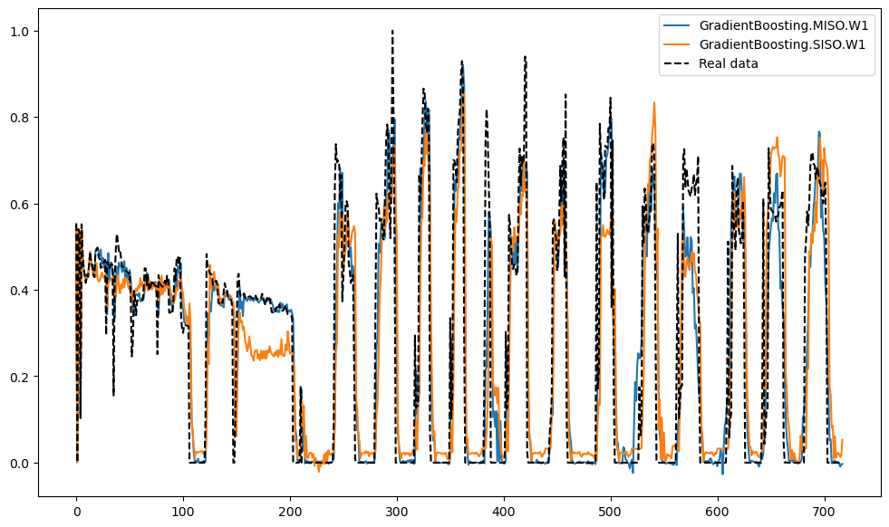
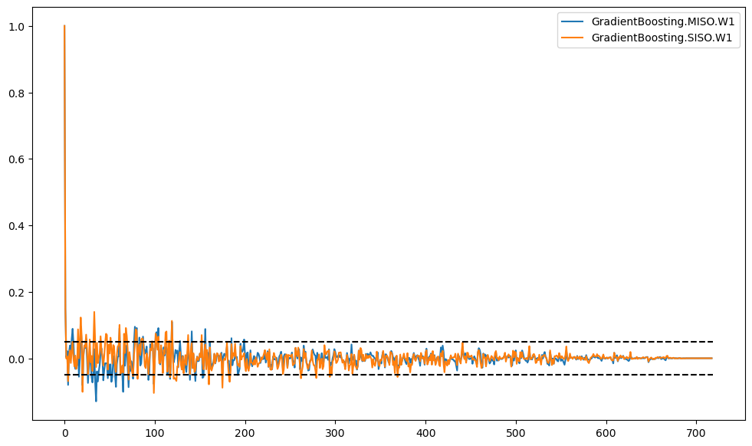
Results
Full forecast free run
OSA error correlation

Slide 17
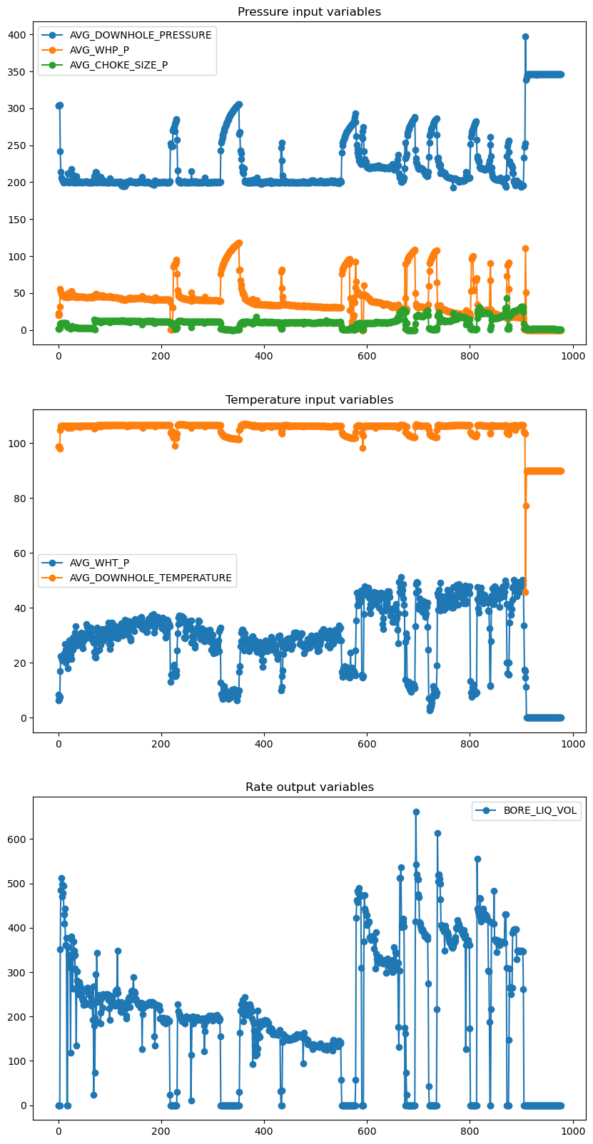
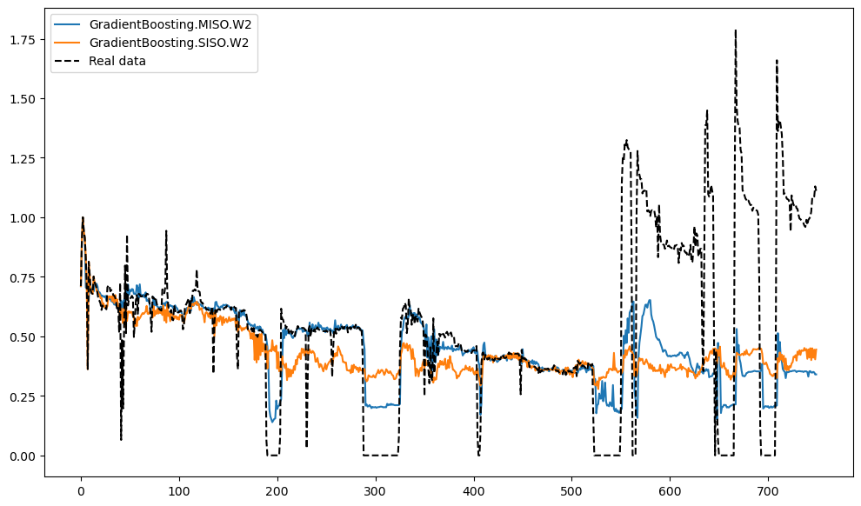
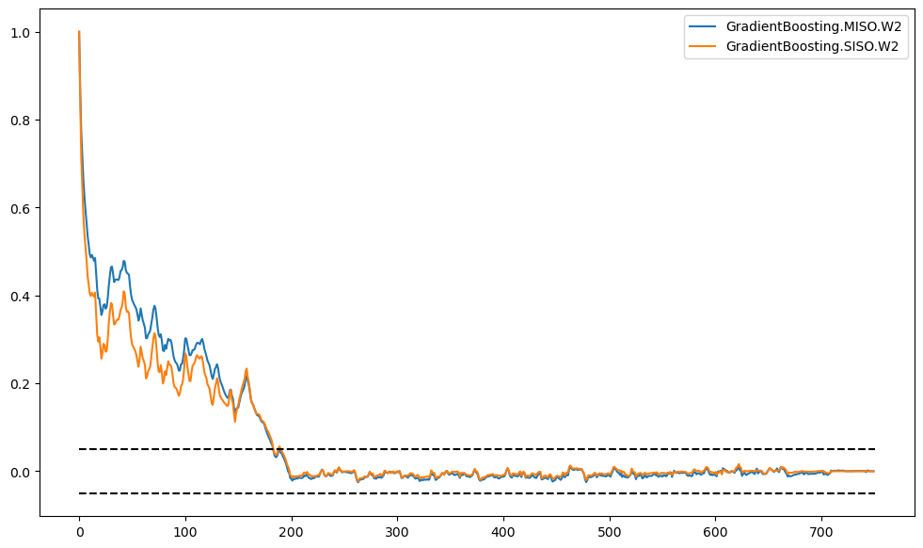
Results second well
Full forecast free run
OSA error correlation

Slide 18
Results second well
Full forecast free run
OSA error correlation

Slide 19
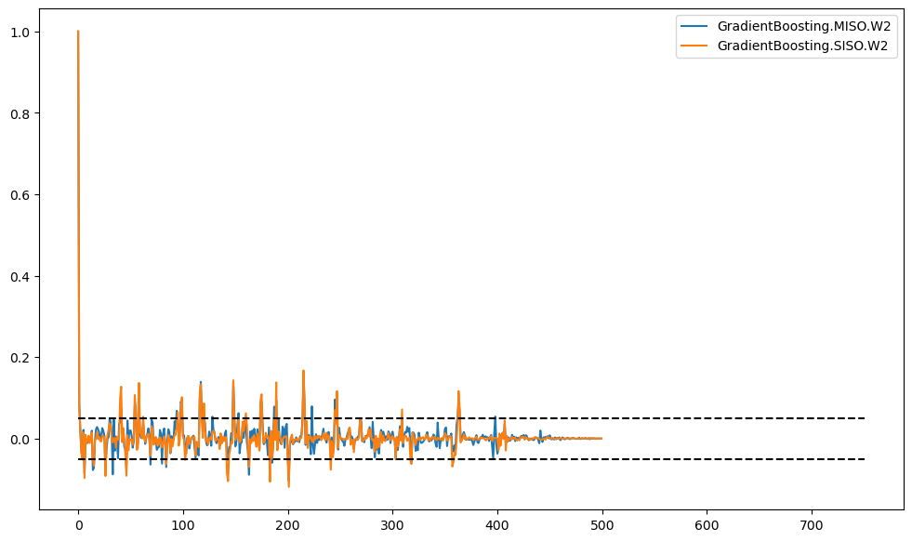
Results second well
Full forecast free run
OSA error correlation

Slide 20
Concluding remarks
SISO Models improve performance as order increases, MISO can achieve good performance in low orders;
Validation set has different dynamics and operational conditions when compared to train set for second well. It can be caused by the complex well dynamic or the lack of sufficient data to understand this behaviour (ex.: fluid injection in reservoir);
Although the R² is about 0.70, timeseries of test predictions show a quite good behaviour, even capturing well shut-in events;
The SYSIDRegressor approach allows the use of any scikit-learn compatible estimator as a regressor in the scope of system identification;

Slide 21
Future work
Try more complex estimators (ex.: Neural Networks)
Investigate more datasets and wells (ex.: SPE Dataset)
Try other combinations of input features and other wells
Add more features from reservoir data (ex.: rates from other wells - interference)
Try Wiener-based models or spectral decomposition techniques to improve model performance

